Slide 1
Cell Energy: Photosynthesis
NB p 63-64

Slide 2
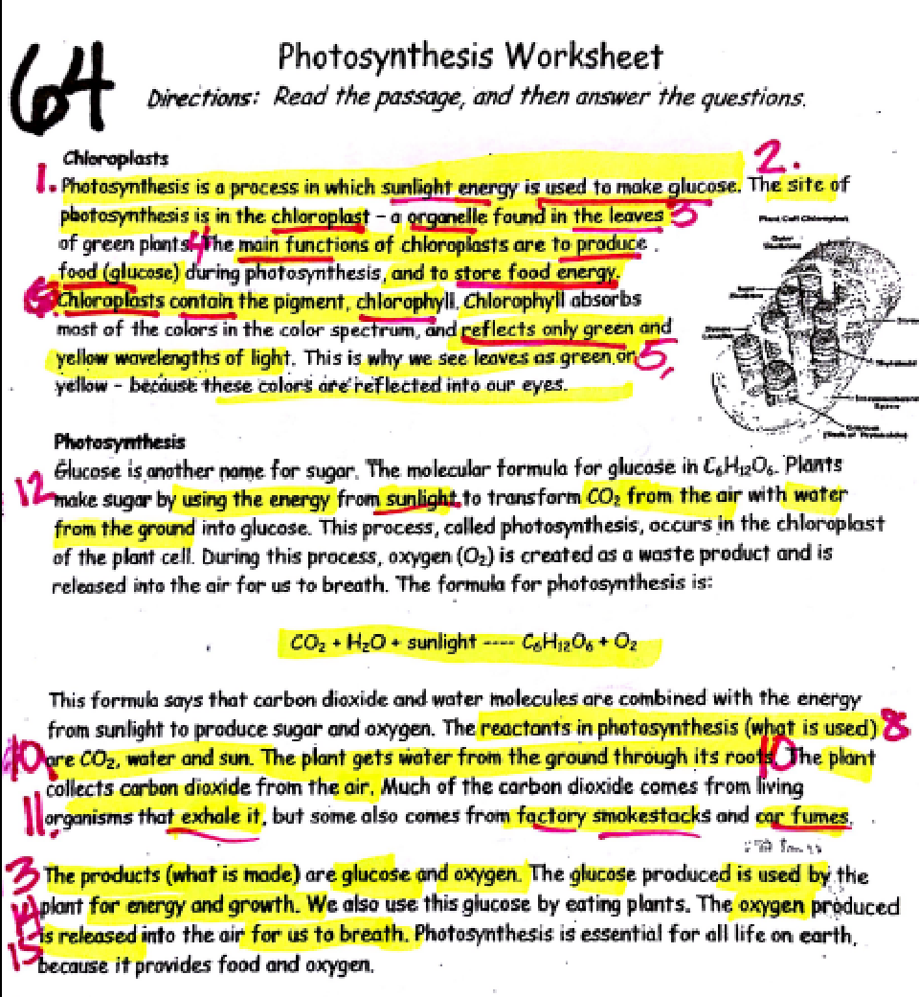

Slide 4
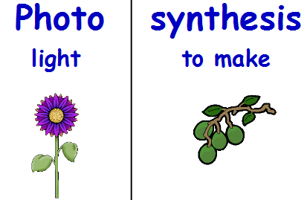
What is Photosynthesis?
Literally means putting together with sunlight
Occurs during day because it needs energy from sunlight

Slide 5
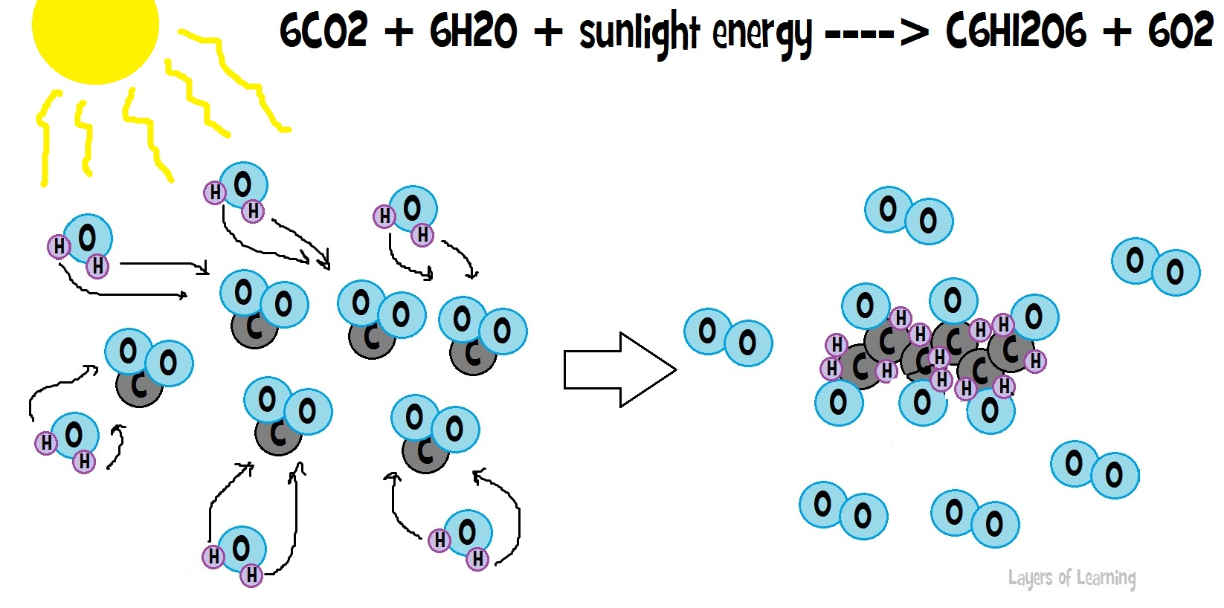
SYNTHESIS: puts smaller molecules together to form larger ones

Slide 6
The process of photosynthesis is a chemical reaction.
Making food/glucose (organic) from (inorganic) carbon dioxide & water
REACTANTS → PRODUCTS
Enter reaction→ are produced
Stuff on left → stuff on right

Slide 7
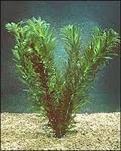
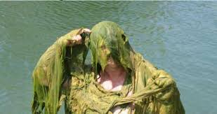
ONLY occurs in plants cells and some algae (single cell plant-like organisms) with a chloroplast

Slide 8
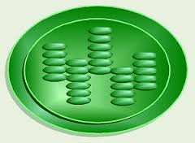
Where in a plant cell does photosynthesis occur?
Inside the green leaves of plants which contain chloroplasts.
The chloroplast contains a pigment called chlorophyll.
chlorophyll
chloroplast
fills the

Slide 9
Chlorophyll is a green pigment that absorbs sunlight.
Chlorophyll is green because it reflects green light

Slide 10
Label the chloroplast with the reactants and products of photosynthesis
Sunlight/ light energy
Glucose/C6H12O6
Water/H2O
Carbon dioxide/CO2
Oxygen/O2

Slide 11
What is the equation for photosynthesis?

Slide 12
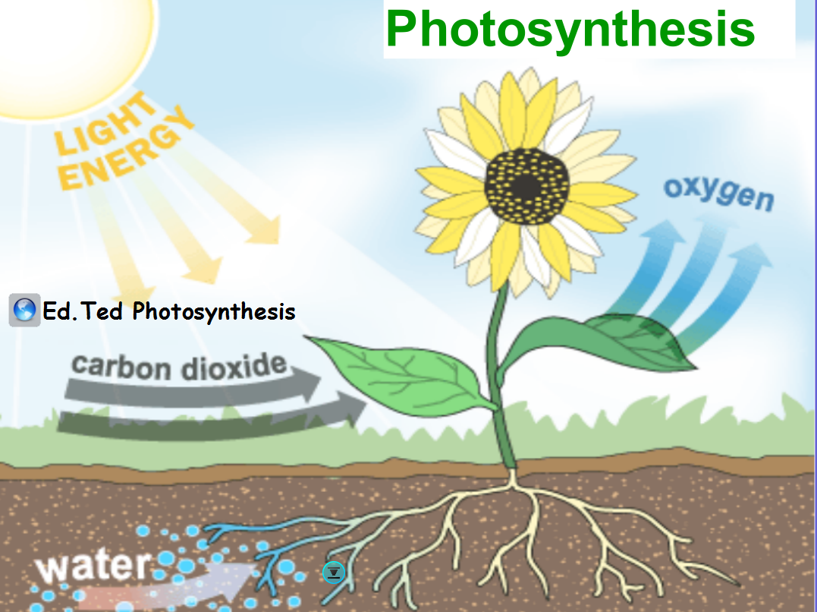
https://www.youtube.com/watch?v=eo5XndJaz-Y

Slide 14
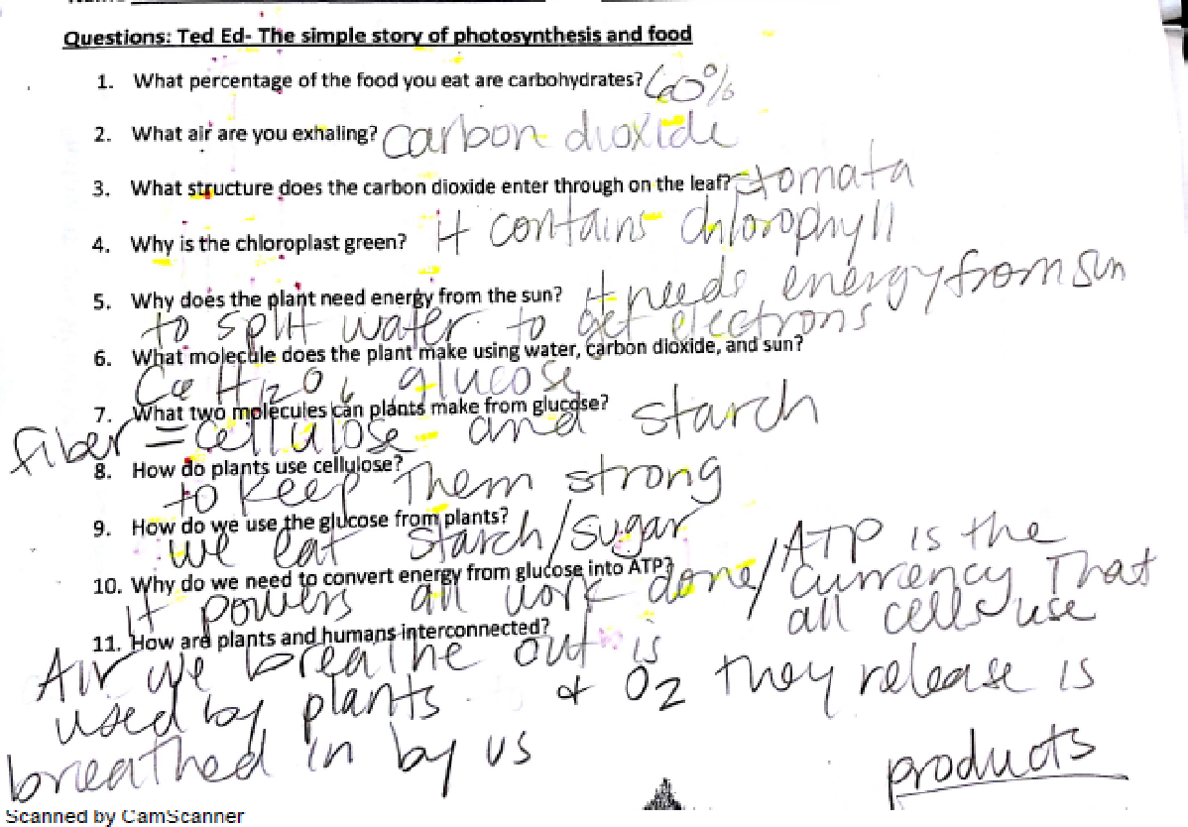

Slide 15
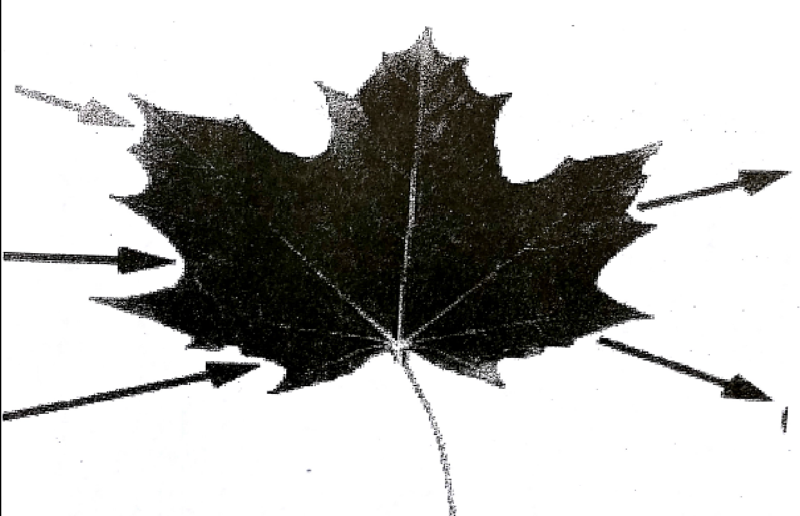

Slide 16
Describe Photosynthesis
The process of changing ______energy to chemical energy
Done by green _____cells
Inside the organelle:___________
Light energy ______as chemical energy
Plants need________, _____and H₂O
Plants produce _________________and O2
light
plant
chloroplast
stored
sunlight
CO₂,
glucose/food/sugar

Slide 17
2 reasons: Why is Photosynthesis important to us?
1. We cannot make our own food (glucose, energy), we must get our food from plants.
Plants are the first step in the food chain.

Slide 18
Why is Photosynthesis important to us?
2. The oxygen released during photosynthesis is necessary for all living things.

Slide 19
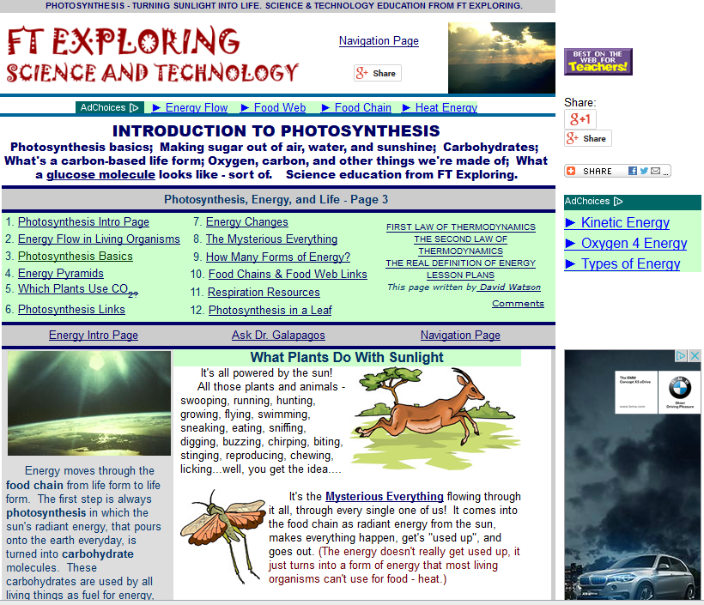
Learn more about photosynthesis at:
http://www.ftexploring.com/me/photosyn1.html

Slide 20
Cell Energy: Respiration
NB p 70-71

Slide 21
Why is Cellular Respiration necessary?
DO NOT COPY
Once the energy that was in sunlight is changed into chemical energy by photosynthesis, an organism (all; plant animal & bacteria) has to transform the chemical energy into a form that can be used by the organism.
This process is cellular respiration.

Slide 22
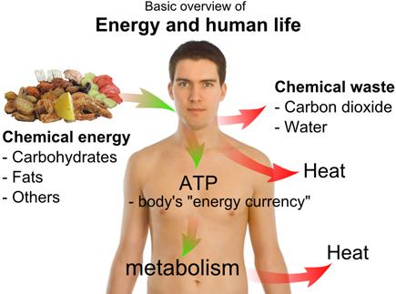

Slide 23
What is Cellular Respiration?
The release of chemical energy for use by cells

Slide 24
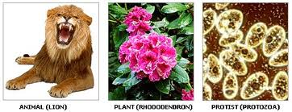
Cellular Respiration
occurs in ALL LIVING THINGS
plants
Animals
Bacteria
Because all organisms get and use energy

Slide 25
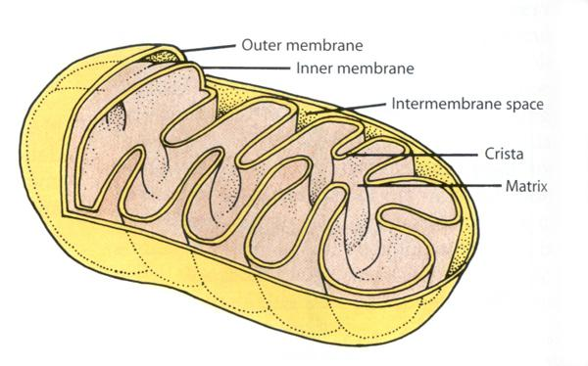
Where in all cells does respiration take place?
Step 1 in the cytoplasm
Step 2 in the Mitochondria
mitochondria
Folded membrane inside increases surface for chemical reactions

Slide 27
Why is Cellular Respiration necessary?
Glucose is a large energy molecule that can’t be used by cells directly
Respiration breaks this glucose down to release the stored energy
ATP is the cell’s energy currency, readily available to do cell work.

Slide 28
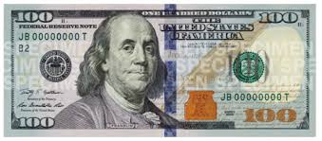
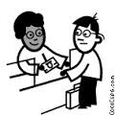
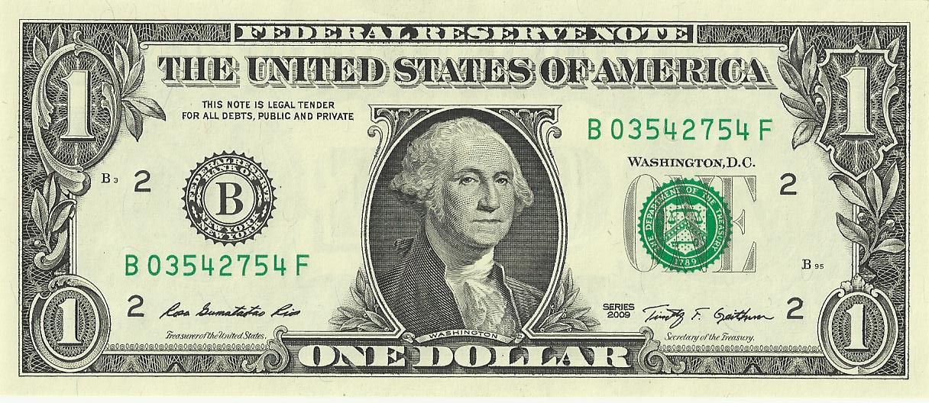
Energy changes from Sun→glucose→ATP
Glucose is like a $100 bill=too big to use
Respiration is like the bank=changes the bills
ATP is like $1 bills = small and easy to spend

Slide 29
Label the mitochondria with the reactants and products of cellular respiration
per 1 left off here
10/8
ATP/energy to do cell work
Oxygen/O2
Carbon dioxide/CO2
Glucose/C6H12O6
Water/H2O

Slide 30
What is the chemical equation for cellular respiration?
+ ATP energy

Slide 31
Describe Cellular Respiration
The process of changing chemical energy to _____ energy
Done by ______cells
Inside the organelle:_____________
Chemical energy is ________as ATP energy
Respiration needs________, and ____
Respiration releases ___________ H₂O and _____
ATP
ALL
mitochondria
released
glucose
O2,
ATP energy
CO2

Slide 32
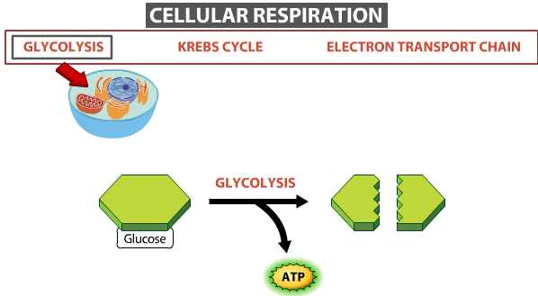
Respiration occurs in several steps:
starts in cytoplasm (all cells)
ends in mitochondria (of eukaryotes)

Slide 33
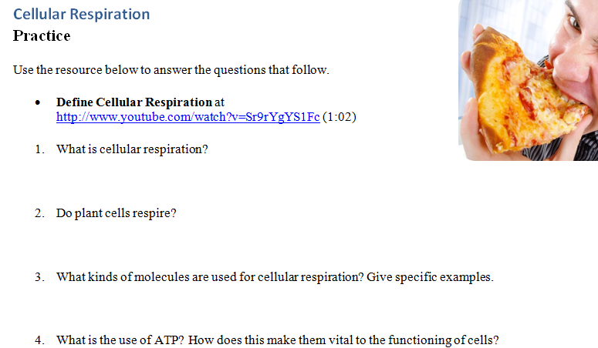
Cellular Respiration video:
https://www.youtube.com/watch?v=Sr9rYgYS1Fc

Slide 34
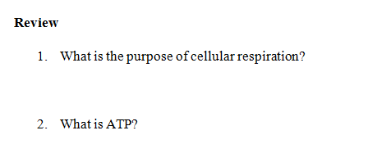
Describe Cellular Respiration

Slide 36
Cell Energy: Photosynthesis vs. Respiration
NB p 72-73

Slide 37
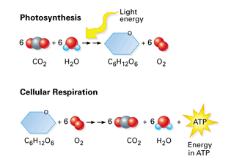
Why they are opposite processes?

Slide 38
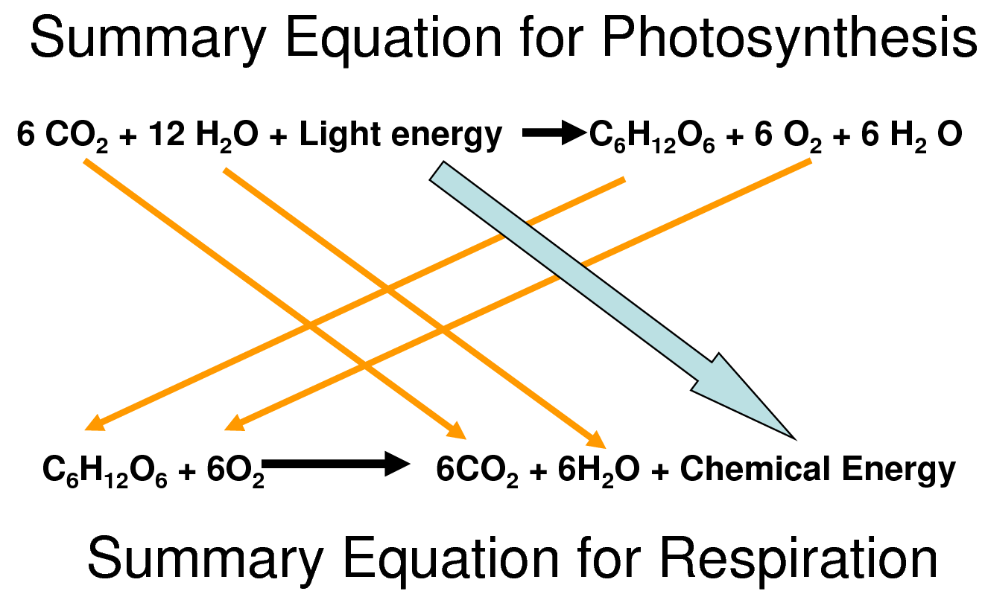
Write and label each equation

Slide 39
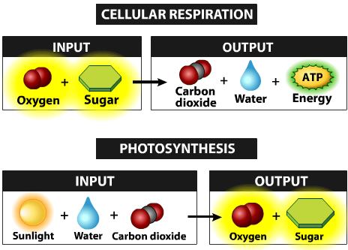
Reactants of one are the products of the other

Slide 40
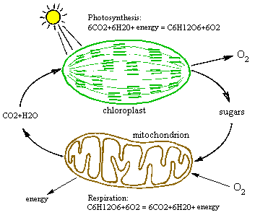
Label your diagram: Reactants → Products

Slide 41
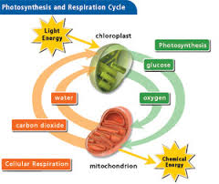

Slide 42
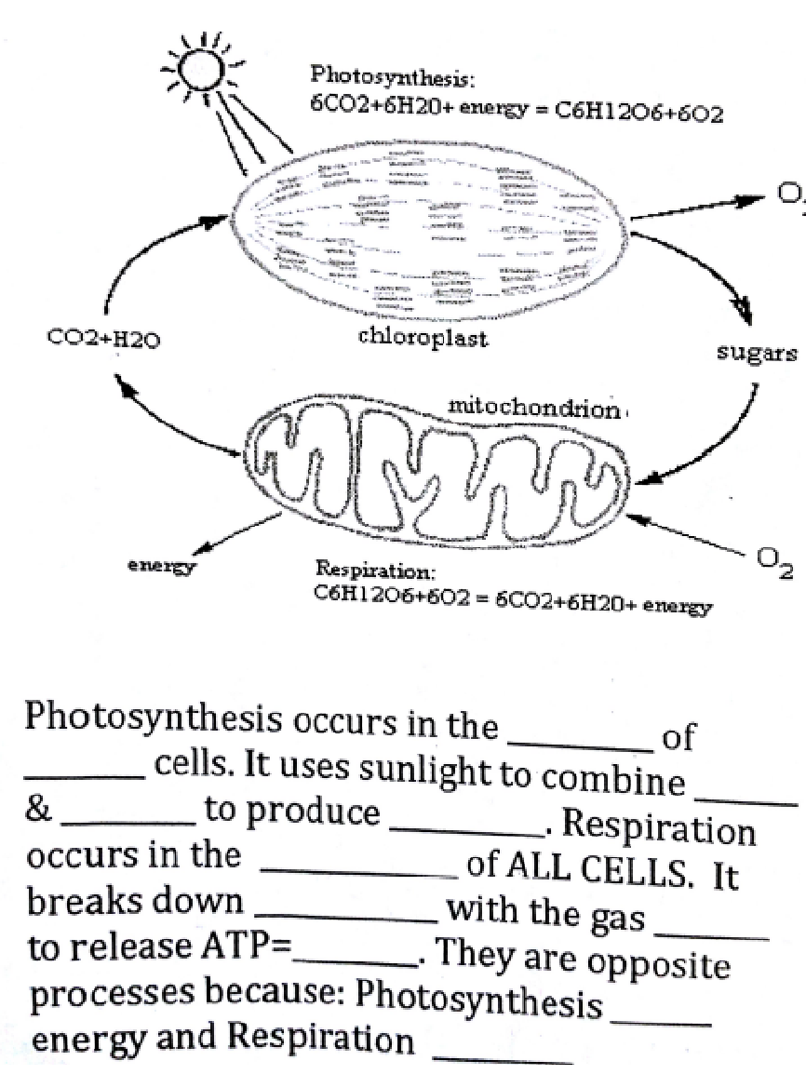

Slide 43
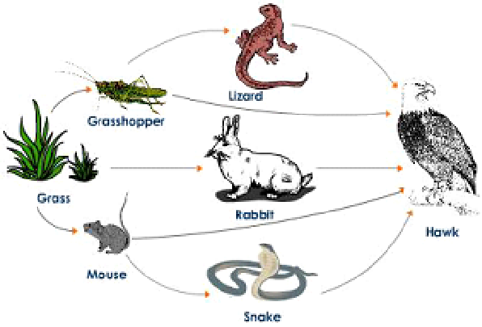
Photosynthesis starts all food chains, respiration keeps the energy flow going

Slide 44
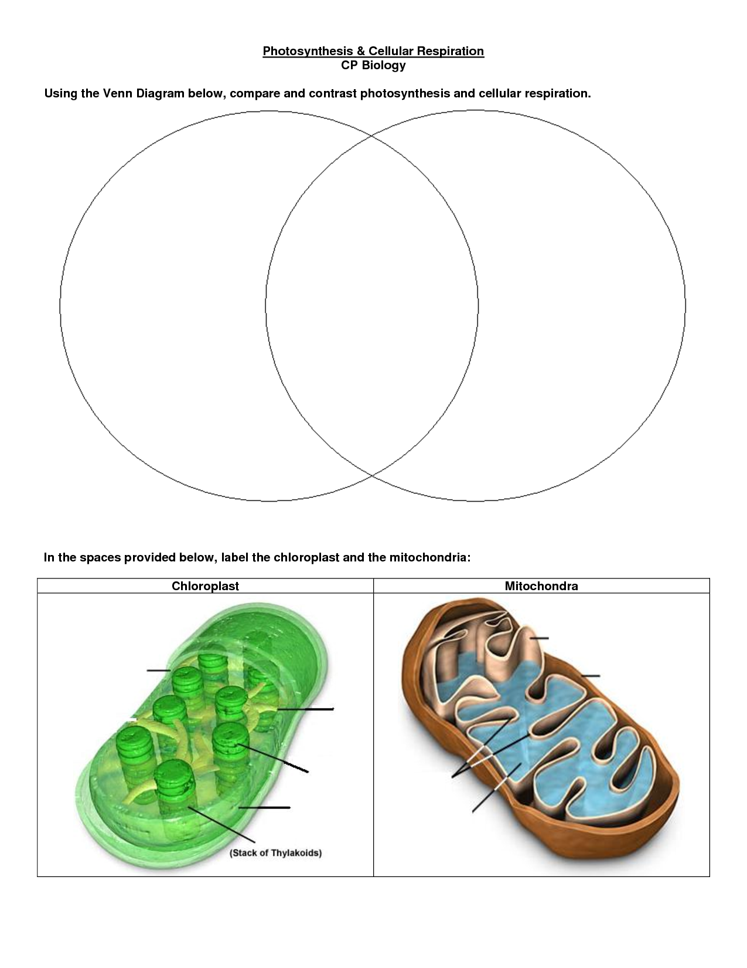
p75

Slide 45
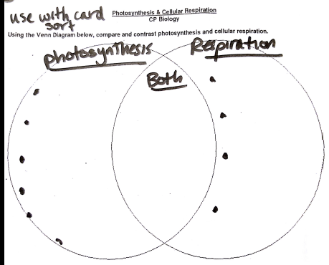
Complete card sort then use to fill in Compare & contrast

Slide 46
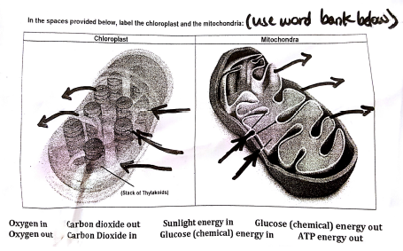
Label the reactants and products

Slide 47
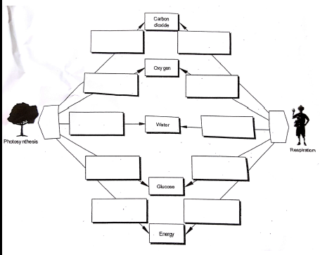
does it USE or PRODUCE?

Slide 48
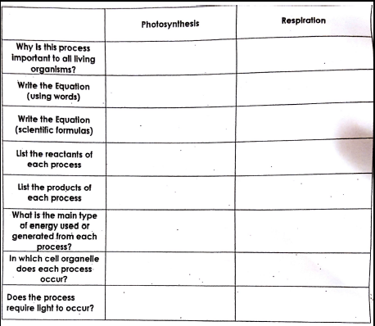
Complete the chart

Slide 49
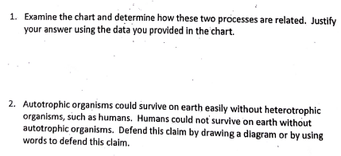
Use the CHART

Slide 50
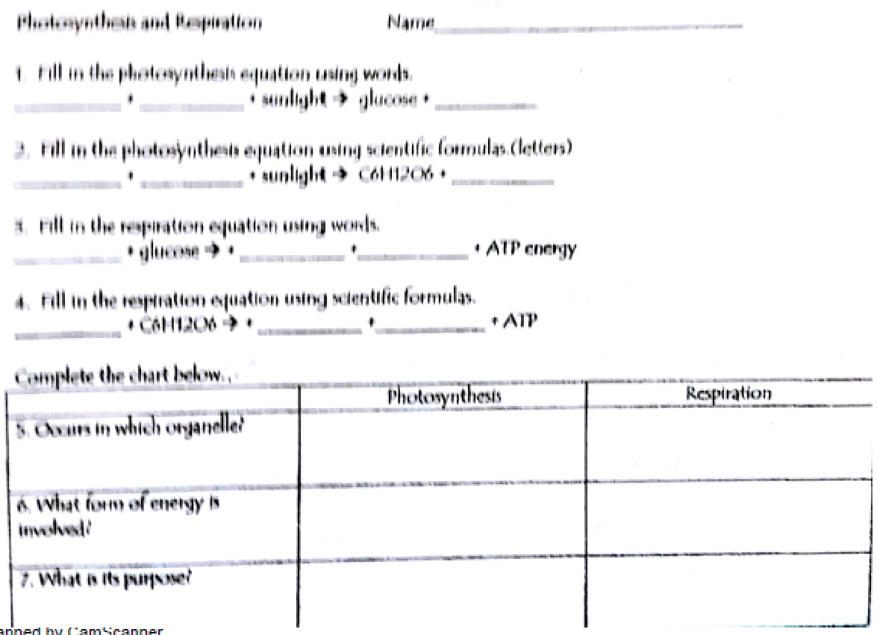

Slide 51
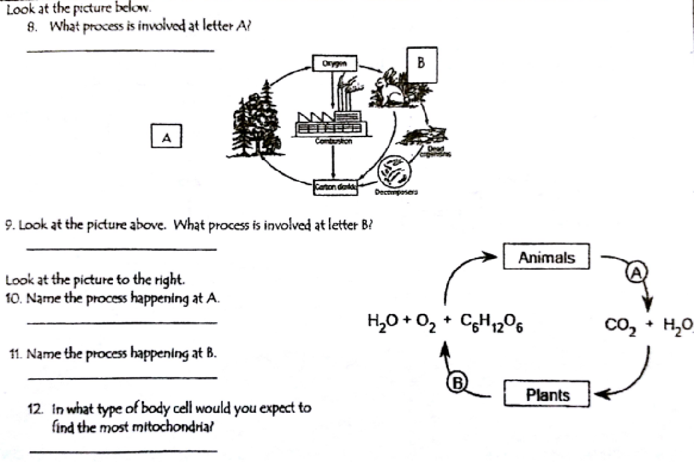

Slide 52
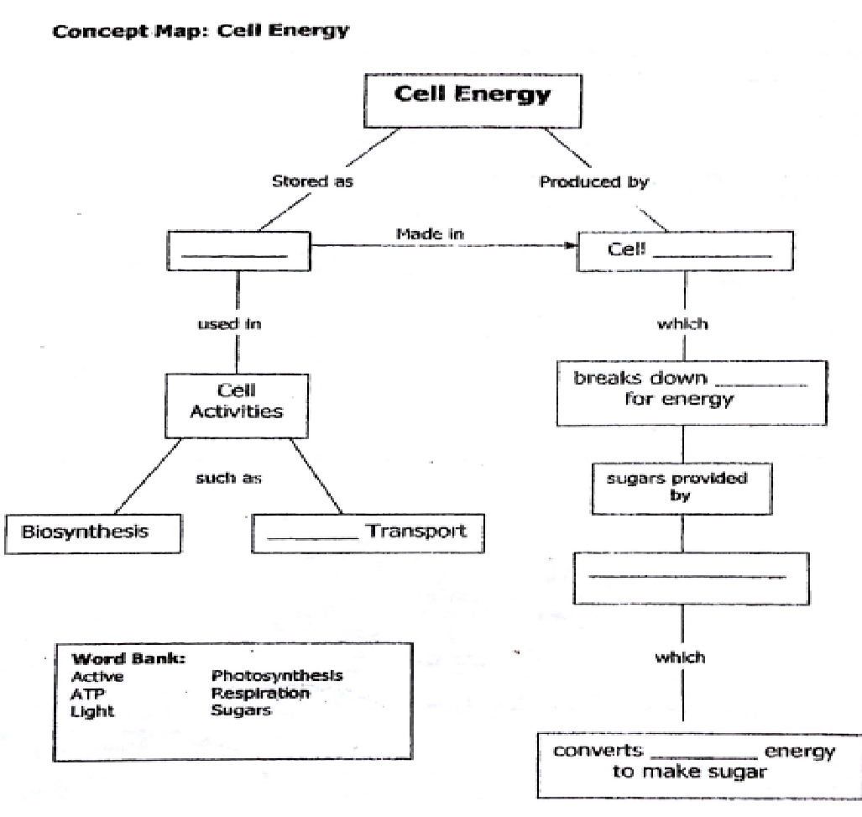

Slide 53
Read how photosynthesis & respiration are related:
http://www.usoe.k12.ut.us/curr/science/sciber00/8th/energy/sciber/photosyn.htm

Slide 54
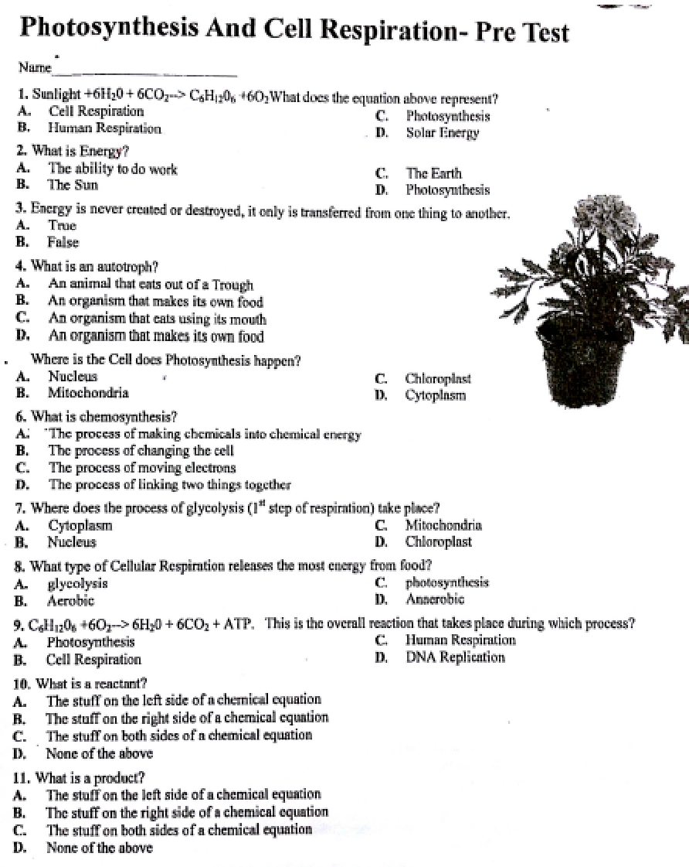

Slide 55
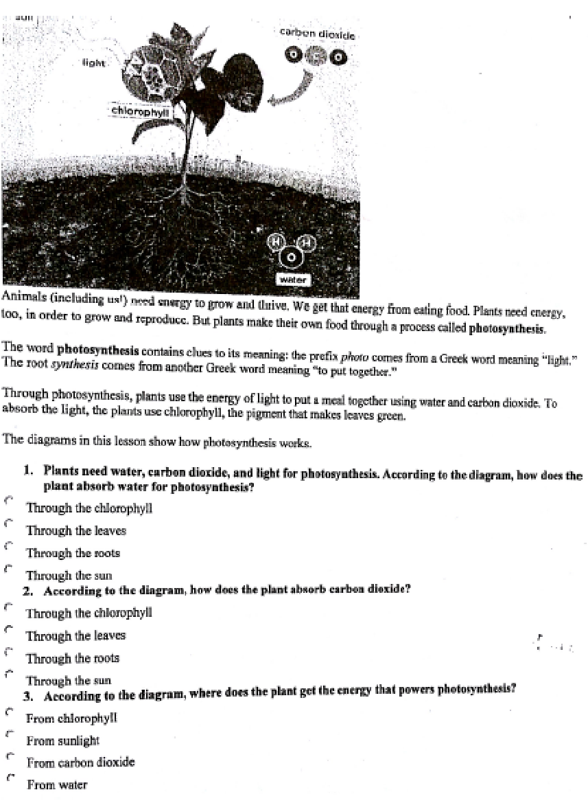

Slide 56
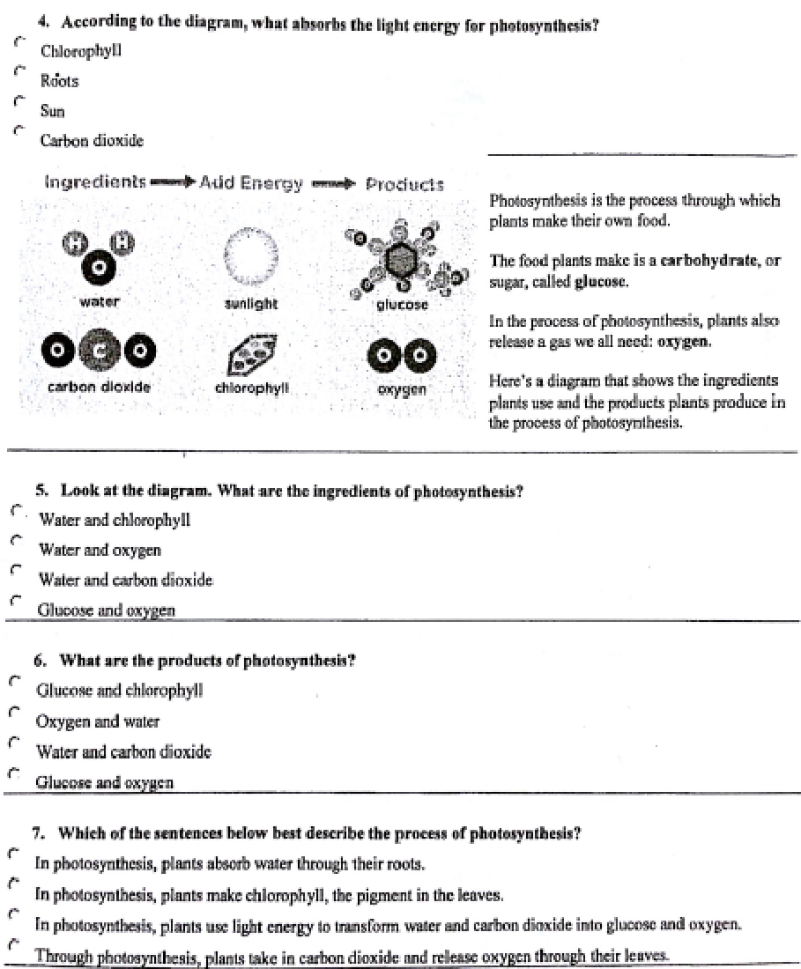

Slide 57
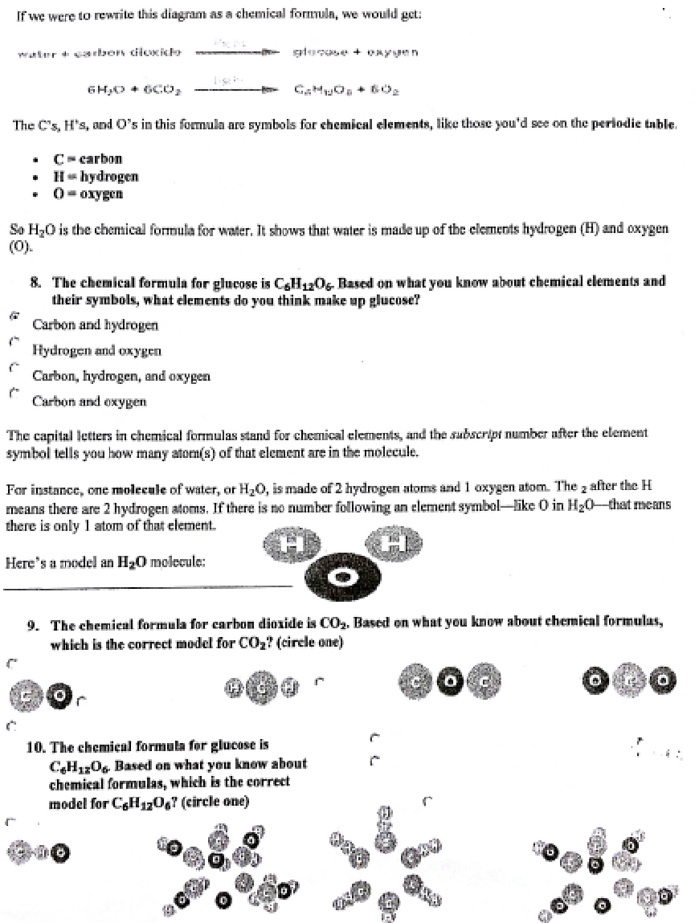

Slide 58
