Slide 1
GENETICS: The study of heredity
Where do you get the traits that people see in you?
Notes:
‹#›

Slide 2
Essential questions
1. What are homologous chromosomes?
2. What is a gene?
3. How do we get traits from our parents?
4. Who is Gregor Mendel?
5. What were Mendel’s contributions to Genetics?

Slide 3
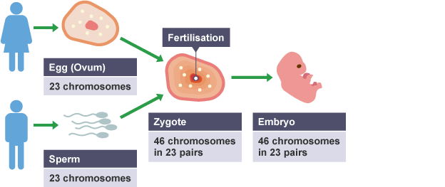
Remember…Sexual reproduction
Sperm + egg = zygote → embryo
At fertilization, homologous chromosomes match up and pair in the zygote=fertilized egg

Slide 4
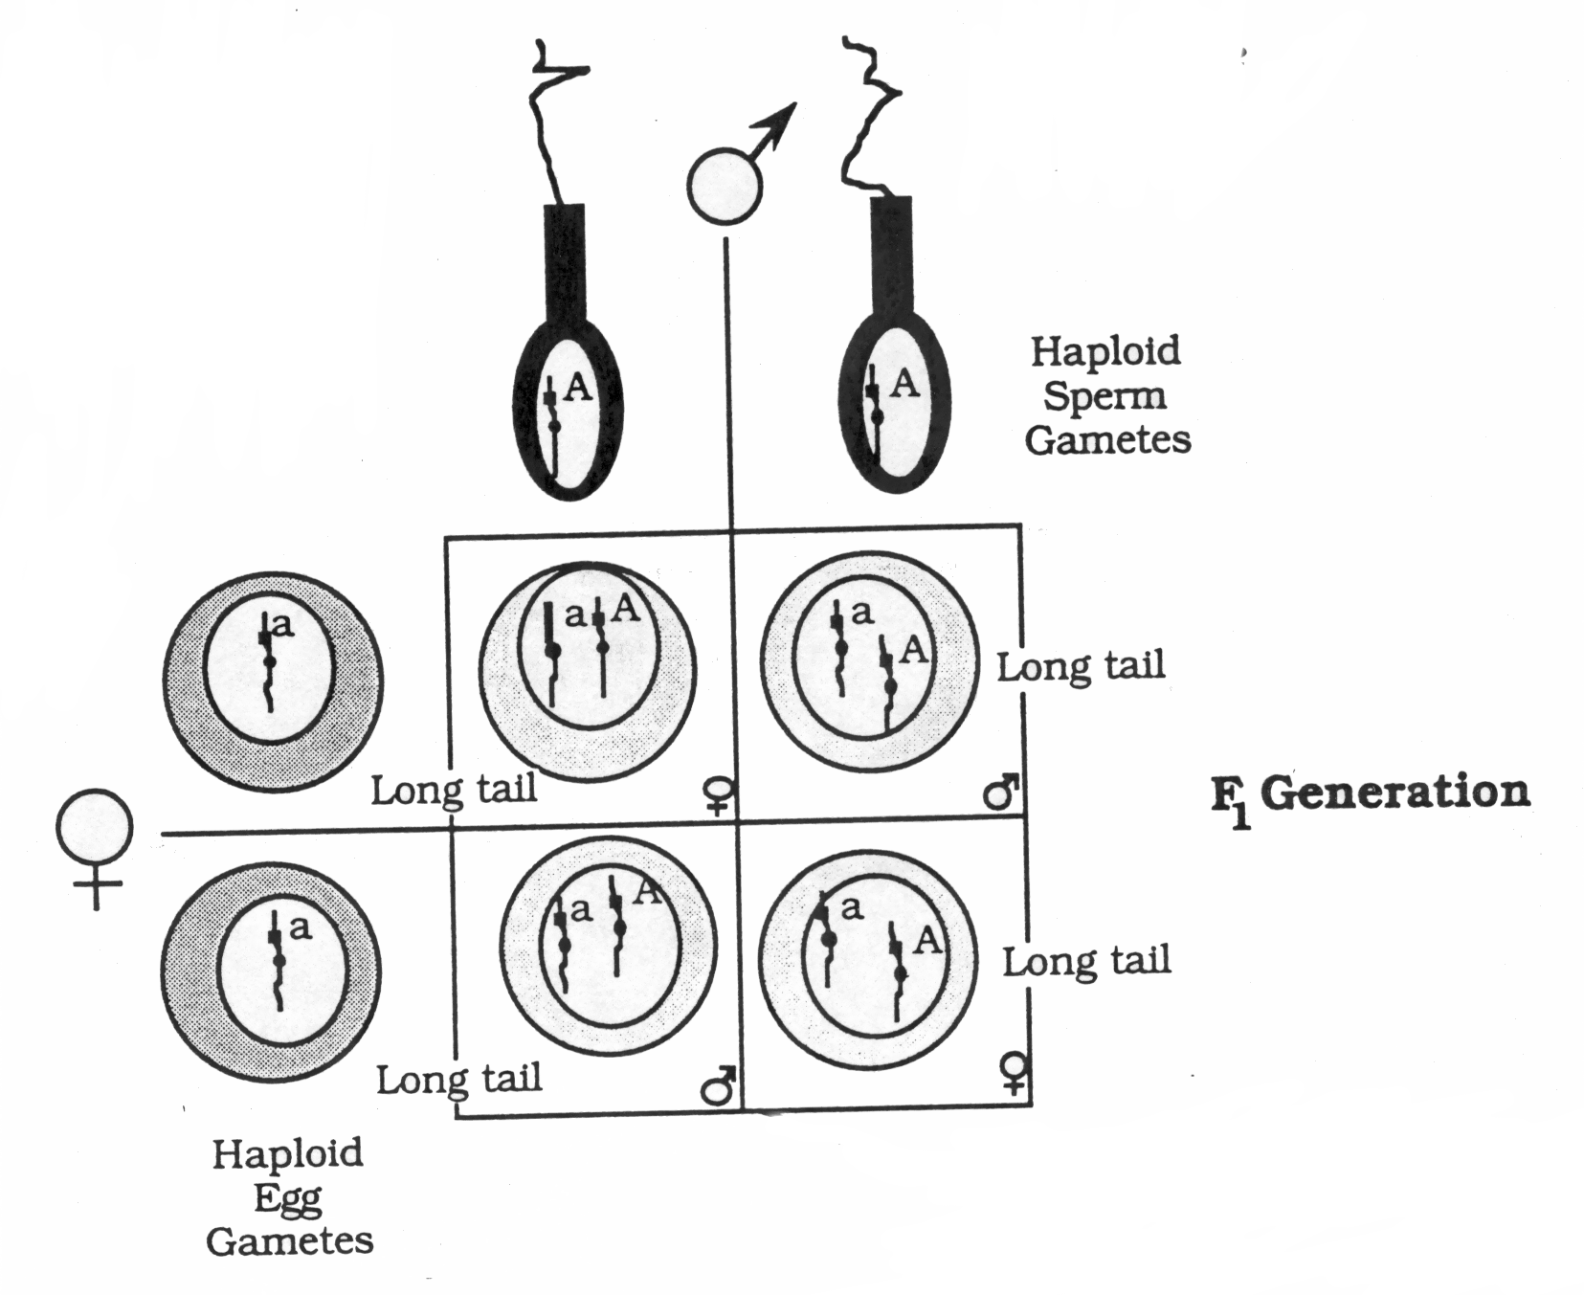

Slide 5
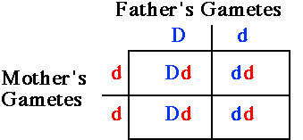
Label the: parents, sperm, egg, zygote, offspring, fertilization

Slide 6
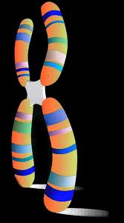
Remember…Chromosomes
Chromosomes are segments of DNA.
Genes are segments of a chromosome that codes for one particular trait.
Trait examples:
Eye Color
Attached ear lobes
Straight hair vs Curly hair
Gene

Slide 7
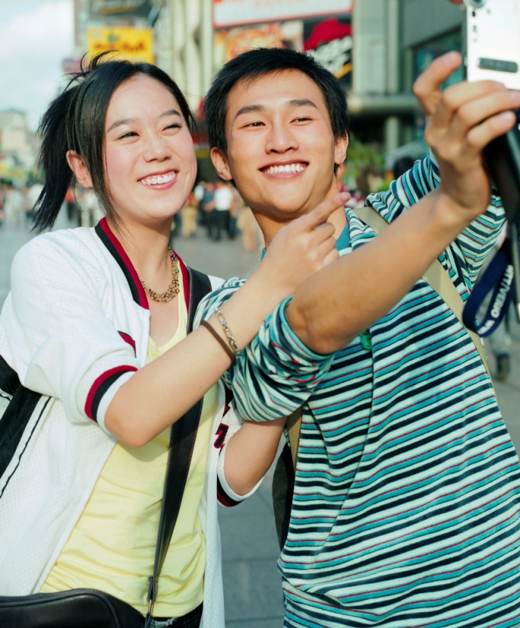
What is a trait?
Characteristics about an organism.
You get your traits from your parents

Slide 8
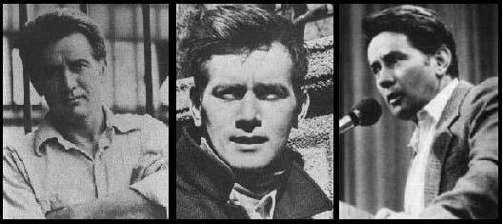
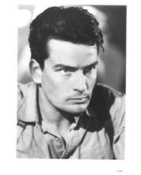
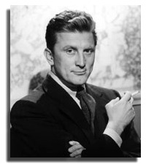
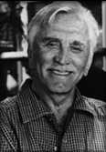
Martin Sheen
Charlie Sheen
Kirk Douglas
Emilio Estevez
Kirk
Michael

Slide 9
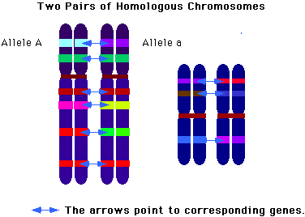
Humans have 23 homologous chromosomes or 23 pairs, 1 set from each parent
Homologous=Same Size

Slide 10
Allele- Different forms of a gene represented by different letters
Ex eye color; can be blue, brown, green. Ex Hair; can be curly or straight
The allele or version of a trait is determined by TWO genes, one from each parent. These alleles can be found in same location on each homologous chromosome.

Slide 11
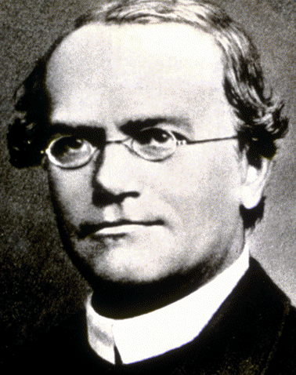
Gregor Mendel
The Father of Genetics
researched using pea plants (peas are self-fertilizing, easily cultivated and cross pollinated)
Notes:
‹#›

Slide 12
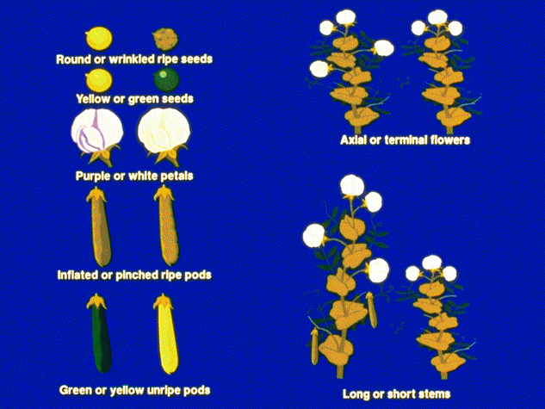
Mendel’s Experiments
Do not copy
Crossed a Yellow Pea plant with a Green Pea plant.
ALL offspring were Yellow
Determined that YELLOW color must be DOMINATE over Green
Notes:
‹#›

Slide 13
Essential questions
1. What are homologous chromosomes?
2. What is a gene?
3. How do we get traits from our parents?
4. Who is Gregor Mendel?
5. What were Mendel’s contributions to Genetics?
answer these now

Slide 14
Essential questions
1. What are Mendel’s 3 principles of genetics?
2. What is meant by Homozygous and Heterozygous?
3. How can you predict genetic outcomes?
4. What are genotypes and phenotypes?

Slide 15
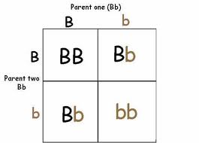
Mendel’s 3 Principles of Genetics; how traits are inherited

Slide 16
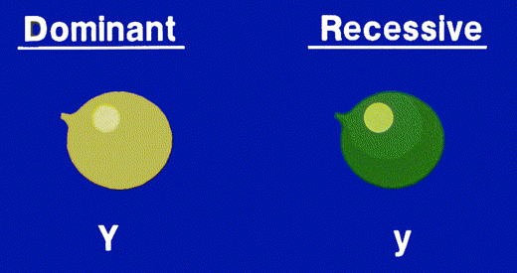
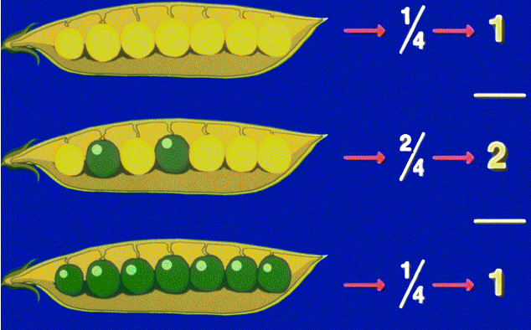
1. Principle of Dominance
Dominant –trait that appears even if only 1 allele (Yy=yellow)
Recessive – Trait that is hidden by the dominant trait. Ony appears if 2 alleles. (yy=green)

Slide 17
Phenotype: Physical Expression of a trait.
Genotype: Gene combinations for a particular trait/characteristic.
Homozygous dominant (YY)
Heterozygous (Yy)
Homozygous recessive (yy)

Slide 18
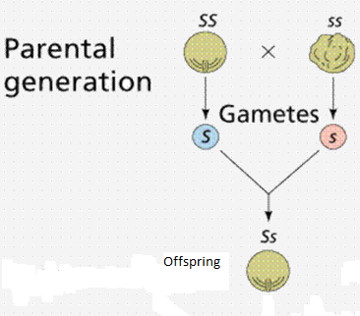
2. Principle of Segregation
The pair of alleles must separate in the parent and ONE gets passed onto the child
Notes:
‹#›

Slide 19
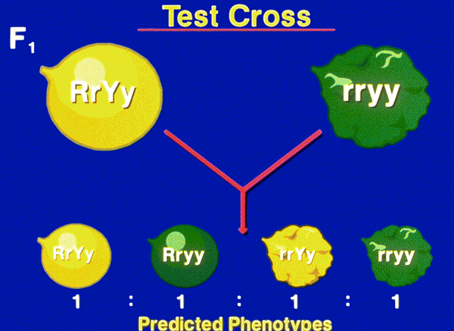
3. Principle of Independent Assortment
One trait’s expression does not affect another s when chromosomes separate during meiosis.

Slide 20
Traits/alleles can be dominant or recessive:
Dominant: stronger gene; always shows, written with capital letter
Recessive: weaker gene; can be hidden by dominant, written with lowercase letter
Phenotype: Physical expression of a trait. Its what you SEE if you take a PHoto-=PHenotype

Slide 21
If you mate=cross two parents, each with a dominant and a recessive trait what offspring will you see

Slide 22
Cont’d
Genotype: Gene combinations for a particular trait/ characteristic. The GENES one has written in letters.
3 possible gene combinations:
Homozygous dominant (YY)
Heterozygous (Yy)
Homozygous recessive (yy)

Slide 23
Remember:
HOMO=same
HETERO= different
Dominant=capital letter R, T, B
Recessive =lowercase letter r, t, b
Lets practice using the vocab.

Slide 24
Solving Genetics problems with Punnett Squares
p132

Slide 25
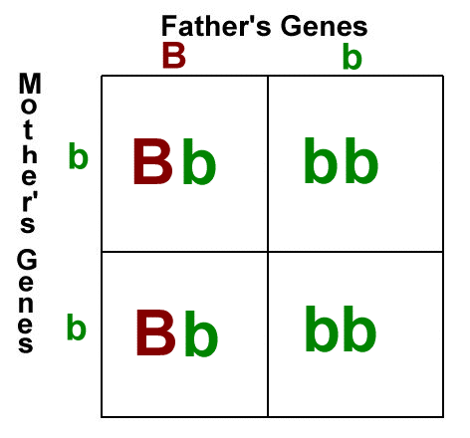
How can we predict genetic offspring?
Punnett squares
A diagram used to predict the genotype and phenotype ratios of different organisms when specific gametes join together

Slide 26
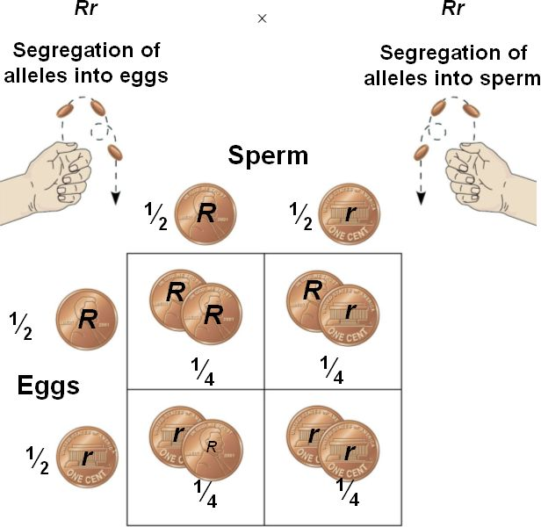
Punnett squares predict the probability of inheriting a particular gene combination

Slide 28
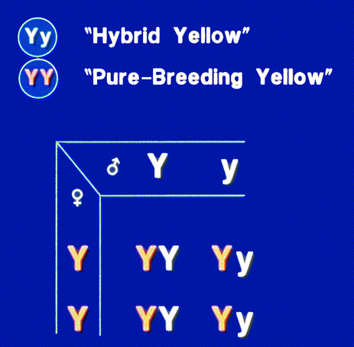
Monohybrid Cross
Involves one trait

Slide 29
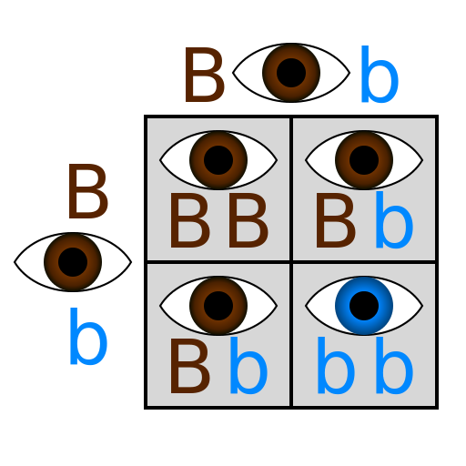
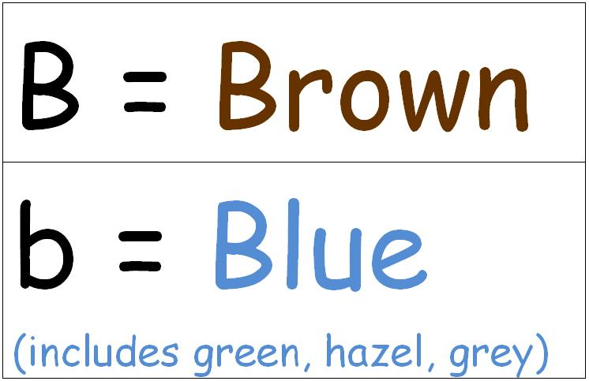
Use a capital letter for dominant trait, lowercase for recessive trait:
Brown eyes are dominant to blue eyes. Show a cross/mating between two heterozygous brown eyed parents.

Slide 30
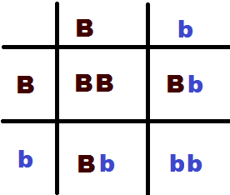

Slide 31
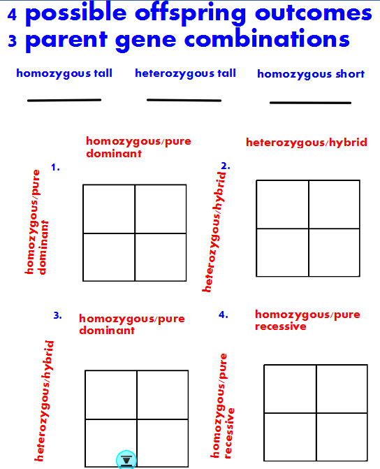

Slide 32
Remember:
HOMO=same
HETERO= different
Dominant=capital letter R, T, B
Recessive =lowercase letter r, t, b
Lets practice using the vocab.

Slide 33
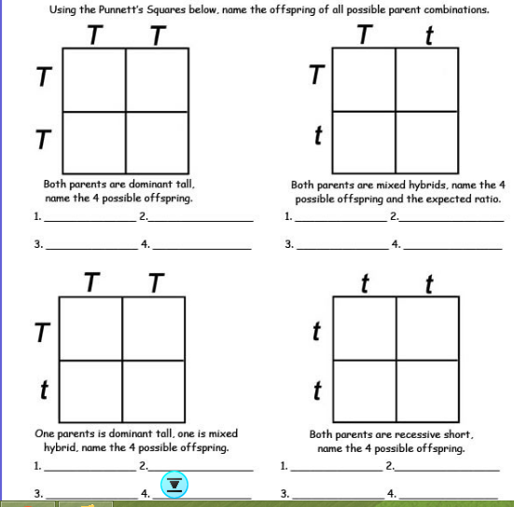

Slide 34
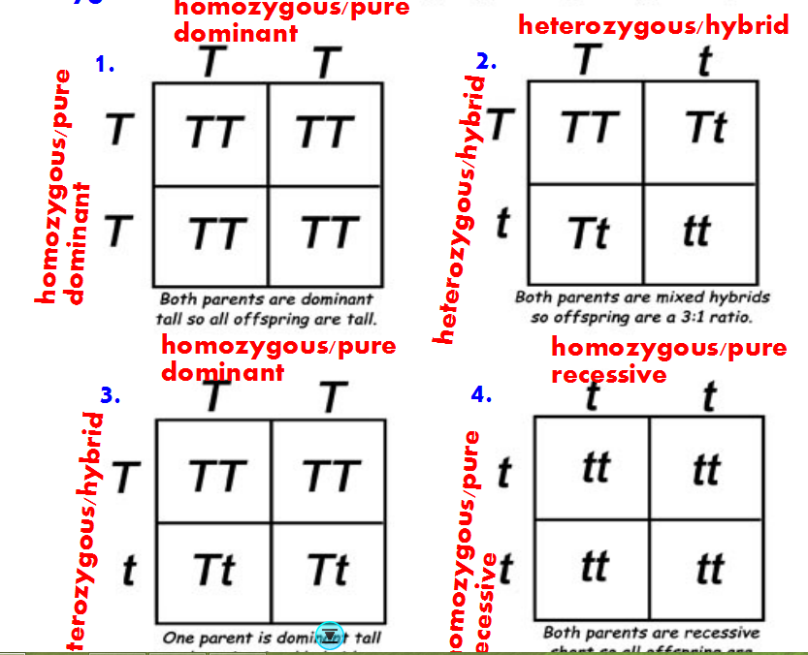

Slide 35
Monohybrid Cross Example
B b
A heterozygous black dog (Bb) mates with a recessive tan dog (bb).
What is the probability that these two dogs will have a tan offspring?
If these two dogs already have 2 tan offspring. What is the probability that their next offspring will be black?
Genotype ratio
Bb, bb- 2:2
Phenotype ratio
Black, tan- 2:2
b
Bb
bb
Bb
bb
b
50%
50%

Slide 38
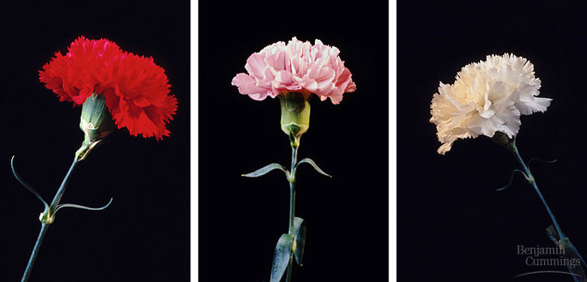
Non-Mendelian Genetics
Essential Questions:
1. What happens when you have two alleles for a trait that are dominant?
2. What is a blended phenotype?
3. If two alleles are dominant, how do I identify which letter to use in the punnett square?

Slide 39
Incomplete Dominance
Neither allele is completely dominant
When the offspring is heterozygous, a third blended phenotype appears

Slide 40
Incomplete Dominance Example
If red flowers (RR) are incompletely dominant to white flowers (WW), show the offspring of a cross between 2 pink flowers (RW)
Q: What is the probability that these two parents will produce pink offspring?
50%
R W
R
W

Slide 41
Incomplete dominance problems
In flowers, Red is incompletely dominant to white. What are the G and P if you cross a Red (RR) and White (WW) flower?
R R
W
W

Slide 42
Incomplete Dominance Example
If red flowers (RR) are incompletely dominant to white flowers (WW), show the offspring of a cross between 2 pink flowers (RW)
Q: What is the probability that these two parents will produce pink offspring?
50%
R W
R
W

Slide 43
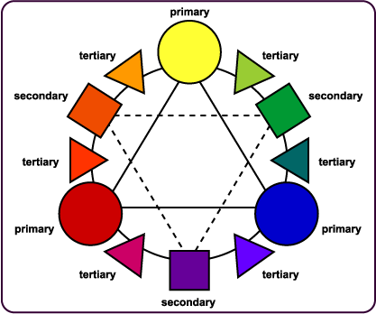
COLOR WHEEL
Red + Blue = Purple
Red + White = Pink
Red + Yellow = Orange
Yellow + Blue = Green

Slide 44
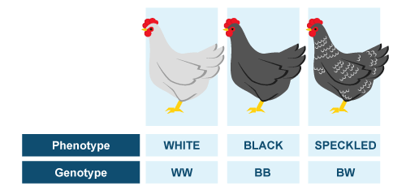
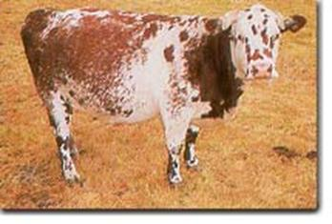
Codominance
Both alleles are equally dominant
When the genotype is heterozygous, both phenotypes are represented in an almost equal ratio
Example:
A black cow and a white cow may produce a black and white cow

Slide 45
If black chickens (BB) are co-dominant to white chickens (WW), show a cross between a black chicken (BB) and a black and white chicken (BW).

Slide 46
Codominance Example
B B
What is the probability that these two chickens will have a white offspring?
0%
W
B
BW | BW
BB | BB
Phenotype ratio:
Black 2, black and white 2, white 0

Slide 47
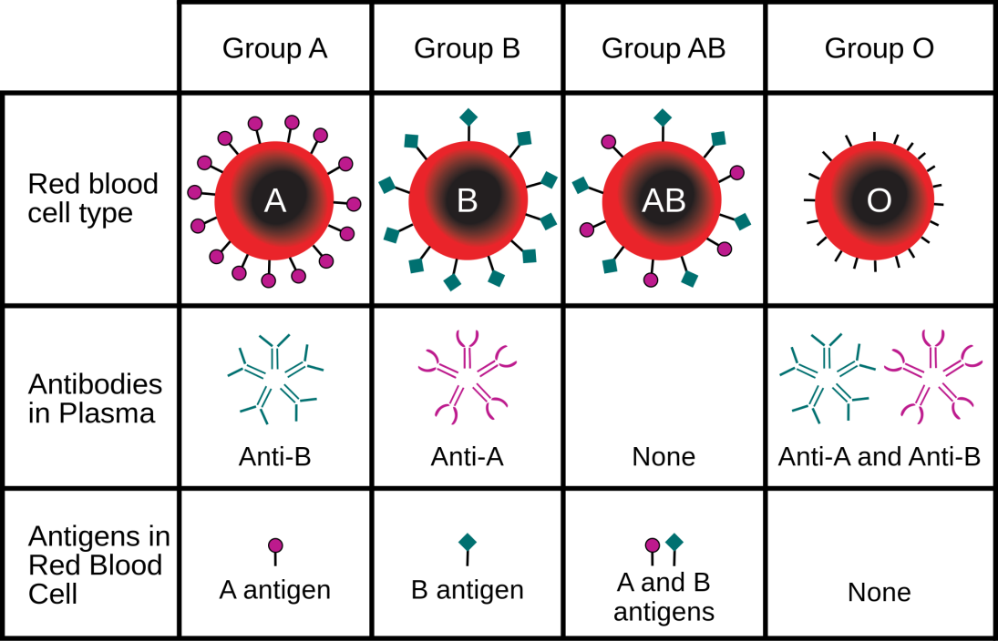
Blood Typing
Human blood genetics exhibit:
Dominance vs. Recessive
and Cod0minance
In humans there are 4 different types of blood:
Type A
Type B
Type AB
Type O

Slide 48
Blood Typing
Type A and Type B are co-dominant
Type O is recessive
Blood types are written using the letter I and a superscript (like an exponent in math).
Example: I^{A}I^{A} would be homozygous dominant for type A blood
I^{B}I^{B} would be homozygous dominant for type B blood

Slide 49
Type O blood
Type O blood is recessive, so the only way to have type O blood is if you have two recessive alleles:
Written: ii
Heterozygous then would look like:
Type A: I^{A}i (This is still type A blood since A is dominant)
Type B: I^{B}i

Slide 50
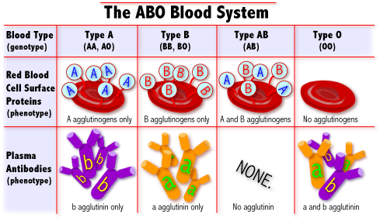
Blood Typing
Since Type A and Type B are Co-dominant, if you receive the A allele from one parent and B allele from the other parent, you would have type AB blood.
Written: I^{A}I^{B}

Slide 51
Blood Typing - Problems
If your mother is Homozygous Dominant for type A blood (I^{A}I^{A}) and your father is type O blood (ii), what are your possible blood types?
What is the probability that you will be type AB?
What is the probability that you will be type O, like your father?

Slide 52
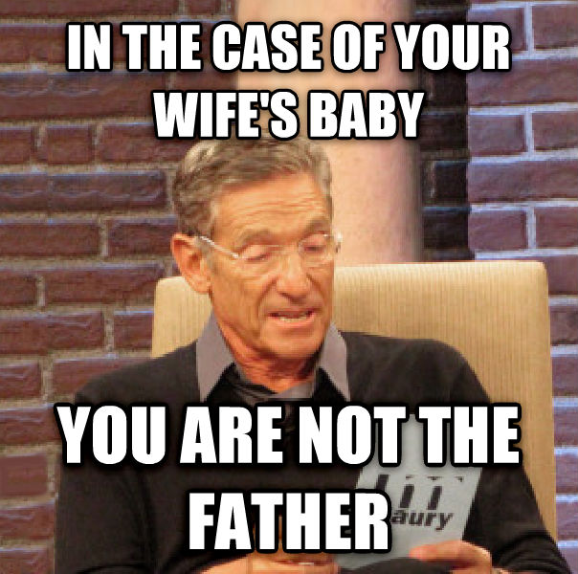
Blood Typing - Problems
Mother: Type O
William: Homozygous B
Daniel: Heterozygous B
BABY: Type O
Which is defiantly NOT the father?

Slide 53
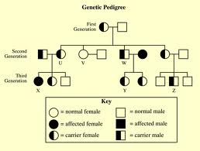
Pedigrees
Pedigrees: Diagrams used to look at multiple generations
Allows you to follow a specific trait through a family history.
Shows who is affected, normal and a carrier for a trait

Slide 54
