Slide 1
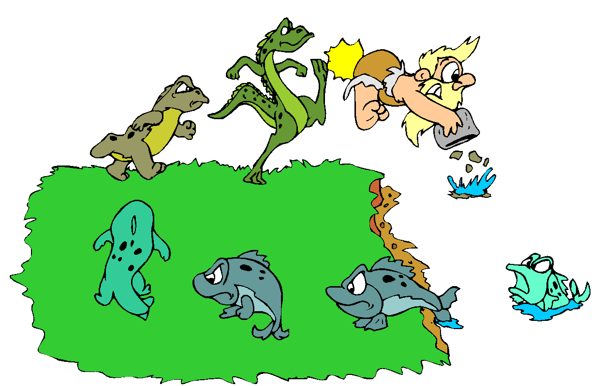
Evolution
CHANGE

Slide 2
Essential Questions
1. Who is Charles Darwin?
2. What was his contribution to science?
3. What is Natural Selection?
4. How does natural selection shape a species?

Slide 3
Early Thinking on the Origin of Life
Spontaneous generation (abiogenesis)
Non-living objects can give rise to living organisms
A stick falls into a stream and turns into a fish
Early Thoughts
Observation: Every year in the spring, the Nile River flooded areas of Egypt along the river, leaving behind nutrient-rich mud that enabled the people to grow that year’s crop of food. However, along with the muddy soil, large numbers of frogs appeared that weren’t around in drier times.
Conclusion: It was perfectly obvious to people back then that the muddy soil gave rise to the frogs.

Slide 4
Spontaneous Generation Disproved
Three experiments disproved spontaneous generation and proved biogenesis (living organisms are descended from other living organisms)
Redi, 1688
Spallanzani, late 1700’s
Pasteur, 1860

Slide 5
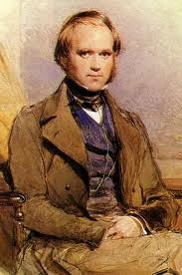
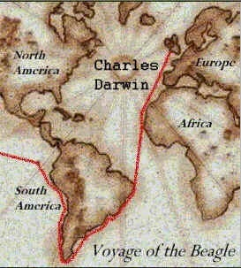
Charles Darwin
Was a Naturalist, a scientist who studied nature and what happens within nature.
His ideas were supported by several forms of evidence
Developed the idea that a species will evolve (Change) due to natural selection

Slide 6
Darwin’s Theory of Natural Selection
Natural selection is the gradual, non-random process by which traits become either more or less common in a population due to mate selection.
Reproductive mate selection takes place and the best traits for survival are chosen for.
Takes thousands of years to affect a population of animals

Slide 7
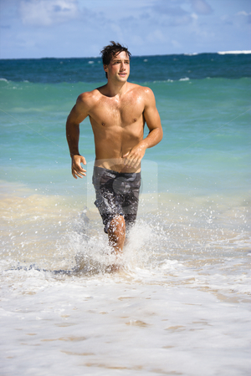
Which male looks like he would be the best mate for reproductive success?

Slide 8
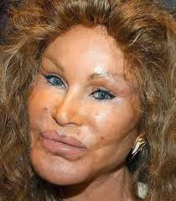
Which female looks like she would be the best mother who could raise and protect her baby?

Slide 9
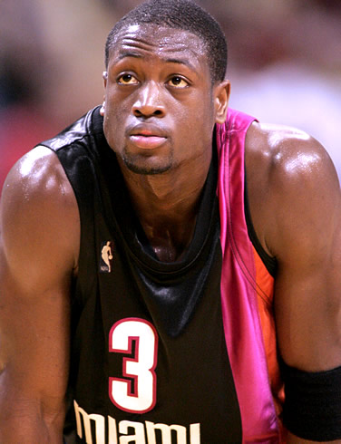
Girls? Do I even need to ask?

Slide 10
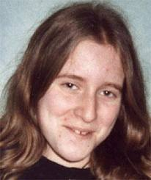
Guys…. Need any help picking out a reproductive mate??

Slide 11
Natural Selection
How are mates selected for in nature? Who has the best traits for survival?
Is it in our DNA who we are attracted to?

Slide 12
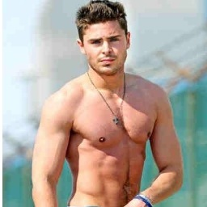
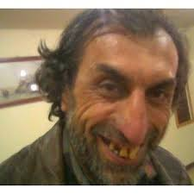
Which male looks like he would be the best mate for reproductive success?

Slide 13
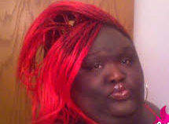
Which female looks like she would be the best mother who could raise and protect her baby?

Slide 14
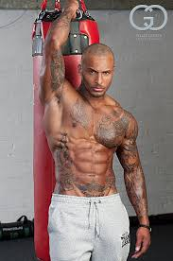
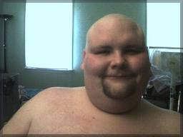
Girls? Do I even need to ask?

Slide 15
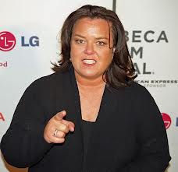
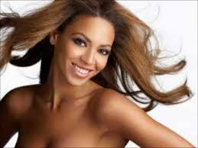
Guys…. Need any help picking out a reproductive mate??

Slide 16
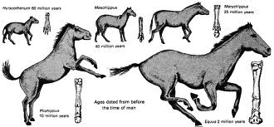
Natural selection causes Change
When years of traits are selected for, or against, it will cause a change in an entire species.
That change is called EVOLUTION

Slide 17
Natural Selection leads to Evolution

Slide 18
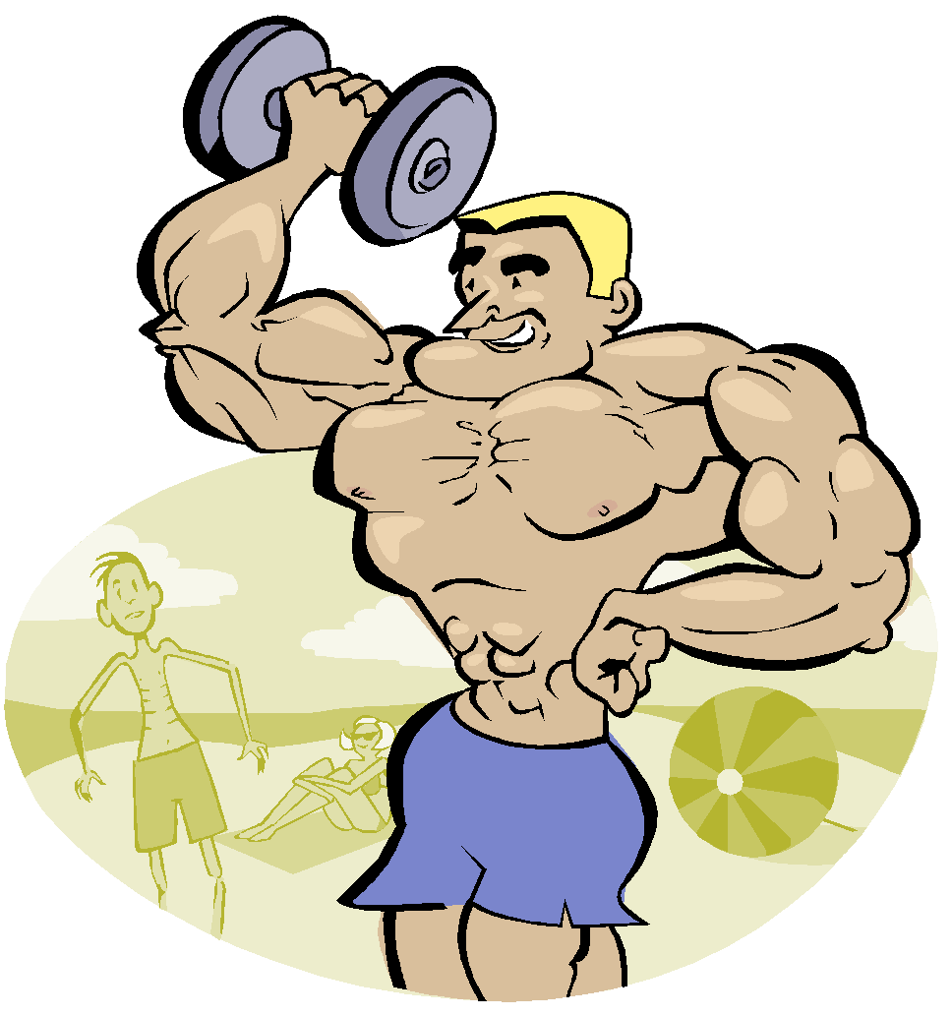
Survival of the fittest
ONLY THE STRONG WILL SURVIVE!!

Slide 19
Essential Questions:
1. What causes evolution?
2. What evidence is there that evolution exists?
3. What is fitness?
4. What happens when an organism is “un-fit” for a particular area?

Slide 20
Natural Selection will cause a species to change.
Darwin’s theory of natural selection is abbreviated as “survival of the fittest”
Fitness – ability of an organism to survive and reproduce.
What happens when an organism is selected against? “loser leaves town!”

Slide 21
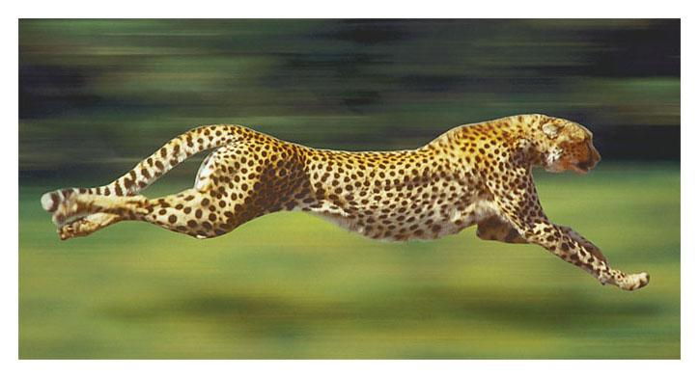
Natural selection rests on three indisputable facts
Remember: OCVS 1. Organisms will Overproduce Offspring will lead to a Competition for resources.
2. Variations in traits will exist between individuals
3. Survival is dependent upon the environment.
Notes:
21
The appendix is thought to be a vestigial structure, because scientists are unsure of the function.

Slide 22
Results of Natural Selection
Adaptive Radiation
When one species evolves into many different species in order to adapt to the environment
This is called speciation

Slide 23
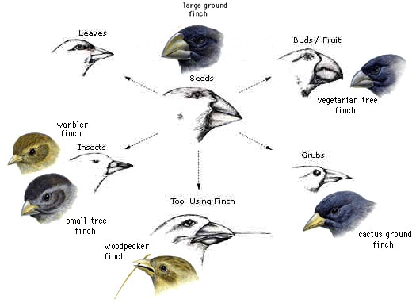
The Variety of Finches
The food source of the finch dictates the beak structure of that species.

Slide 24
Evidence of evolution
Science always asks for PROOF that an event occurs…how do we know evolution occurs if we can’t see the old species??

Slide 25
Evolution of a Species
What evidence is there that a species has evolved?
1. Fossils
2. Vestigial structures
3. Embryology
4. Biochemical similarities
5. Homologous Structures
6. Reproductive Isolation
7. Geographic Isolation

Slide 26
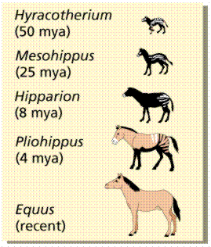
1. Fossils
Physical evidence that an organism lived long ago and is used to help study the past
Archaeopteryx
once considered the first bird
Evolution of Horses determined by Fossils

Slide 27
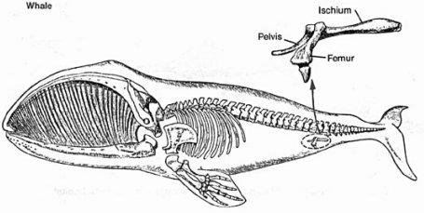
2. Vestigial Structures
A structure found in an organism that is no longer in use but may have been useful at some point in the organism's life.
Example: Whales possess a femur and pelvis, but these bones are no longer useful to the mammals.

Slide 28
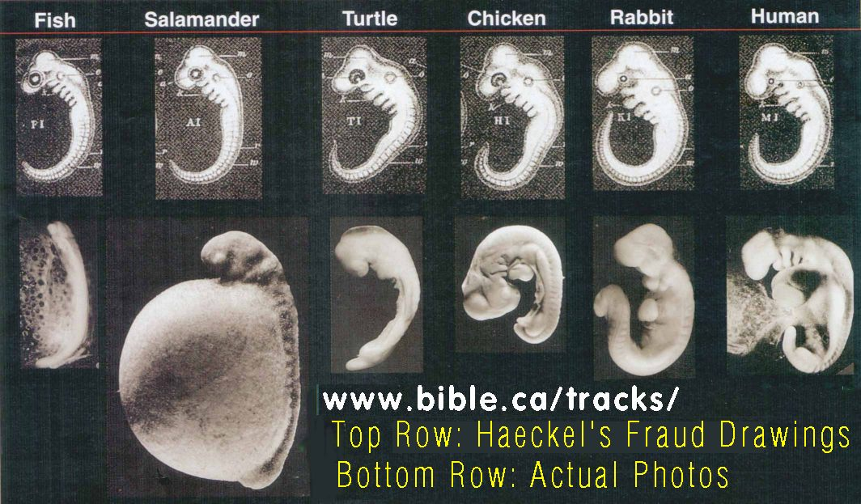
3. Embryology
Similarities among embryos suggest evidence of a common ancestor
Ex. Birds and mammals are similar up to a particular stage of development

Slide 29
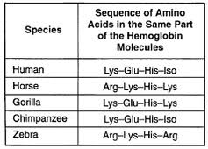
4. Biochemical Similarities
Comparing one organisms DNA with another's, we can see similarities in how DNA codes for common Amino Acids.

Slide 30
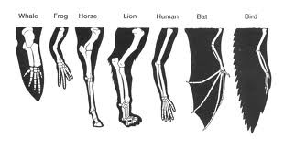
5. Homologous Structures
Structures that have different mature forms, but develop from the same embryotic tissues

Slide 31
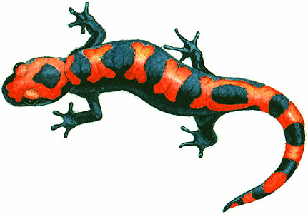
6. Reproductive Isolation
When formerly interbreeding organisms can no longer mate and produce fertile offspring
Two Types:
Genetic Makeup
Example: Salamanders in California
Behavioral
Example: If one type of tree frog mates in the summer and another mates in the fall.

Slide 32
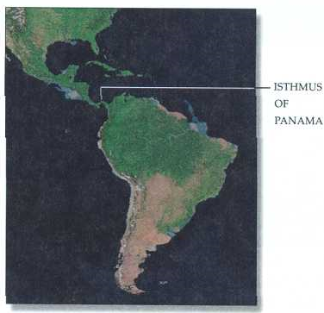
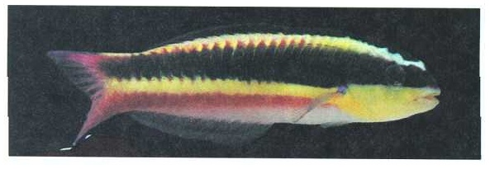
7. Geographic Isolation
Whenever a physical barrier divides a population
Ex. Oceans, Mountains
ATLANTIC SIDE
PACIFIC SIDE

Slide 33
Origins of Life on Earth and future impacts of evolution
1. How did life on Earth Evolve into what we currently have?
2. What are some benefits and potential dangers to a species evolving?

Slide 34
Origins of Life
Where did the first life on Earth come from??

Slide 35
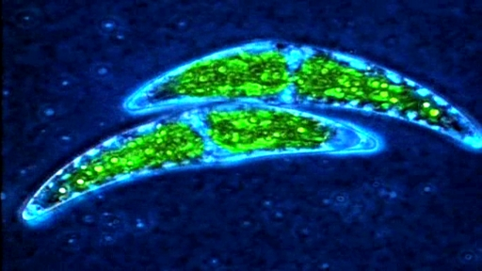
Evolution of Cells
Believed that the first organisms on Earth were anaerobic prokaryotic cells.
Lived the “primordial soup”
Atmosphere was made up mostly of Carbon Dioxide
Believed that a prokaryotic cell absorbed a photosynthetic bacteria which started to provide the original cell with glucose through photosynthesis.

Slide 36
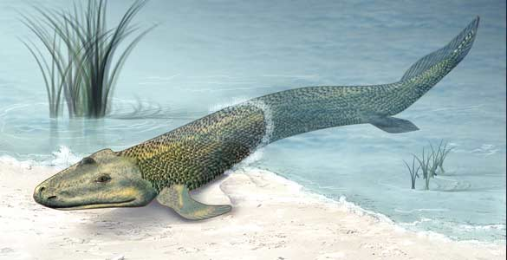
Over the next 3.5 Billion years….
The photosynthetic bacteria produce enough oxygen to change the atmosphere into what it currently is.
Single celled bacteria evolve into multi-cellular organisms in the oceans
Ocean organisms evolve and adapt to life on land

Slide 37
Evolution happening TODAY
How does evolution of a species affect your lives today?

Slide 38
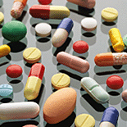
Development of Immunity
Just like external features have evolved to permit survival of the species, internal mechanisms have also evolved to increase survival
How?
Genetic Mutations
But, microorganisms have also evolved and can resist antibiotics
Over treatment causes resistant bacteria

Slide 39
Antibiotics
Antibiotics are substances that slows or stops the growth of bacteria.
Most widely known antibiotic - penicillin
There are many types of bacteria, some beneficial, some harmful
Good:
Bacteria in our intestines which aid in digestion.
Bad:
Bacteria which cause pneumonia or Strep.

Slide 40
Antibiotic resistance
The over prescription of antibiotics can cause only the “super bugs” to remain.
Example: MRSA
Antibiotics basically stop working against these bacteria since they have now evolved a resistance to their effects.

Slide 41
Pesticide resistance
Similar to antibiotic resistance in bacteria, Insects can become pesticide resistant
Pesticides are chemicals designed to kill insects (pests).

Slide 42
Types of Natural Selection
Stabilizing
Directional
Disruptive

Slide 43
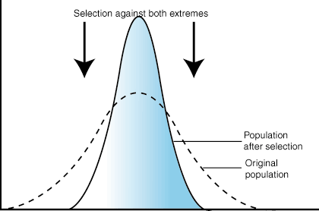
Stabilizing Selection
Stabilizing selection results in a decrease of a population's genetic variance when natural selection favors an average phenotype and selects against extreme variations.

Slide 44
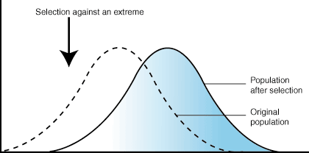
Directional Selection
a mode of natural selection in which a single phenotype is favored, causing the allele frequency to continuously shift in one direction

Slide 45
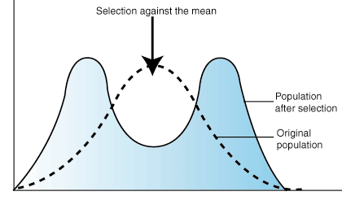
Disruptive Selection
a mode of natural selection in which extreme values for a trait are favored over intermediate values

