Slide 1
DNA and Protein Synthesis
Your genetic blueprint

Slide 2
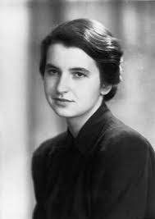
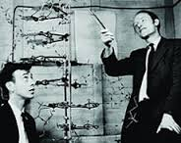
DNA Structure
Found in all living things
DNA = Deoxyribose Nucleic Acid
Building Blocks: Nucleotides
Nucleotides – made of 3 parts:
1. Sugar - Deoxyribose or Ribose
2. Phosphate group
3. Nitrogen bases – A, T, C, G & U
Shape: Double Helix

Slide 3
Discovered by:
Watson and Crick (and Rosiland Franklin) in 1953
Importance of shape: Explained how the molecule could make millions of exact copies with “no” errors.
How does the molecule make exact copies?
Replication

Slide 4
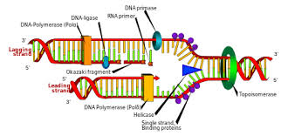

Slide 5
REPLICATION – making Exact copies
This process is ENZYME DRIVEN:
Enzymes break down the hydrogen bonds between the nitrogen bases and DNA molecule “unzips”
Free nucleotides in the cytoplasm binds to the single strands by base pairing (A-T and G-C)
An enzyme binds to the new base pairs together to form 2 new strands
Complementary copy of each strand of DNA is generated
Enzymes then check the new DNA for mistakes

Slide 6
Mutations
Mistakes made in DNA replication
2 specific types of mutations:
1. POINT mutation-
one base is substituted for another
Original: GGT ATC GGA TTA
Replicated: GGC ATC GGA TTA
2. FRAME SHIFT mutation-
one base is added or deleted and it shifts sequence
Original: GGT ATC GGA TTA
Replicated: GGA TCG GAT TA
- T was deleted thus causing the whole molecule to shift

