Slide 1
Cellular Respiration
Energy production in all eukaryotic cells

Slide 2
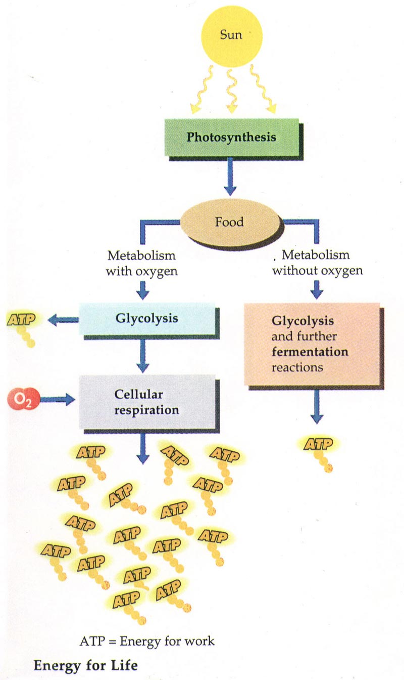
Cellular Respiration
The process by which mitochondria breaks down food molecules to produce ATP
Takes place in all living cells
May take place WITH or WITHOUT oxygen

Slide 3
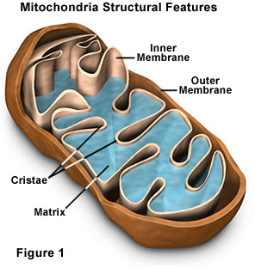
Mitochondria
Site of the cellular respiration
“Bean” shaped
Complex foldings inside of the organelle called Cristae

Slide 4
Aerobic Cellular respiration
Aerobic: In the presence of OXYGEN
Chemical Formula:
O2 + C6H12O6 → CO2 + H2O + ATP
Words:
Oxygen + Glucose YIELDS Carbon Dioxide, Water and ENERGY

Slide 5
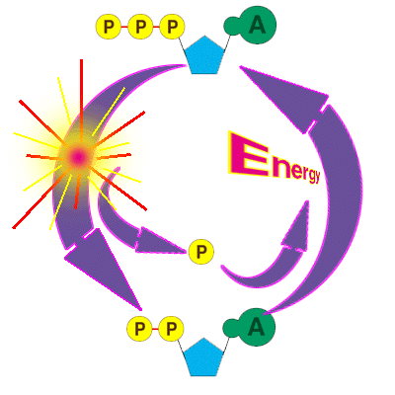
ATP - adenosine triphosphate
A molecule of energy which is created by the mitochondria when the cell undergoes cellular respiration

Slide 6
Anaerobic Respiration
Anaerobic: Without Oxygen
Occurs when an organism needs to create energy, but does not have the available oxygen.
Creates Lactic Acid in muscles

Slide 7
Anaerobic vs Aerobic
Aerobic:
requires oxygen
Produces much, much more energy
Examples:
Cellular respiration in animals
Anaerobic:
no oxygen is required
Produces a small amount of energy
Examples:
Alcohol creation
Lactic acid fermentation
A plant’s creation of ATP

